Slide 1


1.
ANALYSIS ON
GARMENT WORKER'S PRODUCTIVITY
Presented by:
Group - 3
BHAVANS VIVEKANANDA COLLEGE
group members:
SRAVAN KUMAR / VAMSHI / SRI VANI / NITHIN CHANDRA

Slide 2
Abstract:
2.
This project focuses on analyzing and modeling productivity among garment factory workers using a detailed dataset comprising various production and worker-related metrics.
The study focuses on multiple machine learning algorithms, including: Regression,KNN,SVM,Decision trees, and ensemble algorithms.
Objective:
The primary objective of this project is to analyze and predict the productivity of garment factory workers by examining various production and workforce factors

Slide 3



3.
Content:
Introduction - 4
Literature review - 5
Data pre-processing - 8
Exploratory Data Analysis - 16
Machine Learning Algorithms - 27
Summary - 37
Appendix - 43

Slide 4

4.
Introduction:
Purpose: Analyze productivity trends, identify influential factors, and use machine learning models to predict productivity.
The garment manufacturing industry is characterized by complex processes and various factors that influence worker productivity.
This project focuses on analyzing a dataset related to garment workers' productivity, which includes variables such as working hours, incentives, idle time, work-in-progress (WIP), and productivity targets.
Conducted exploratory data analysis (EDA) to understand distributions and correlations.
Checked and addressed multicollinearity using VIF.
Evaluated various machine learning models, including regression, KNN, SVM, decision trees, and ensemble techniques (bagging and boosting).
Compared model performance before and after handling multicollinearity to identify the most effective predictive approach.

Slide 5

5.
LITERATURE
REVIEW

Slide 6
6.
Literature review - 1:
Technological and Incentive Impacts: Studies such as Kumar and Saha (2019) have examined how the use of technology and performance incentives (reflected in your dataset's incentive column) affect productivity.
Kumar ,
Patel
&
Patel emphasizes the importance of visual tools like scatter plots, box plots, and histograms for uncovering patterns and relationships between variables before applying predictive models.
Saha
Published in International Journal of Commerce
and Management Research.

Slide 7
7.
Literature Review - 2
Statistical and Machine Learning Techniques for Analysis: To analyze the factors influencing productivity, Smith and Jones (2020) suggest regression models and machine learning approaches as valuable tools.
John
&
Smith
he Journal of Management Studies published by Wiley-Blackwell
on behalf of the Society for the Advancement of Management Studies​​

Slide 8

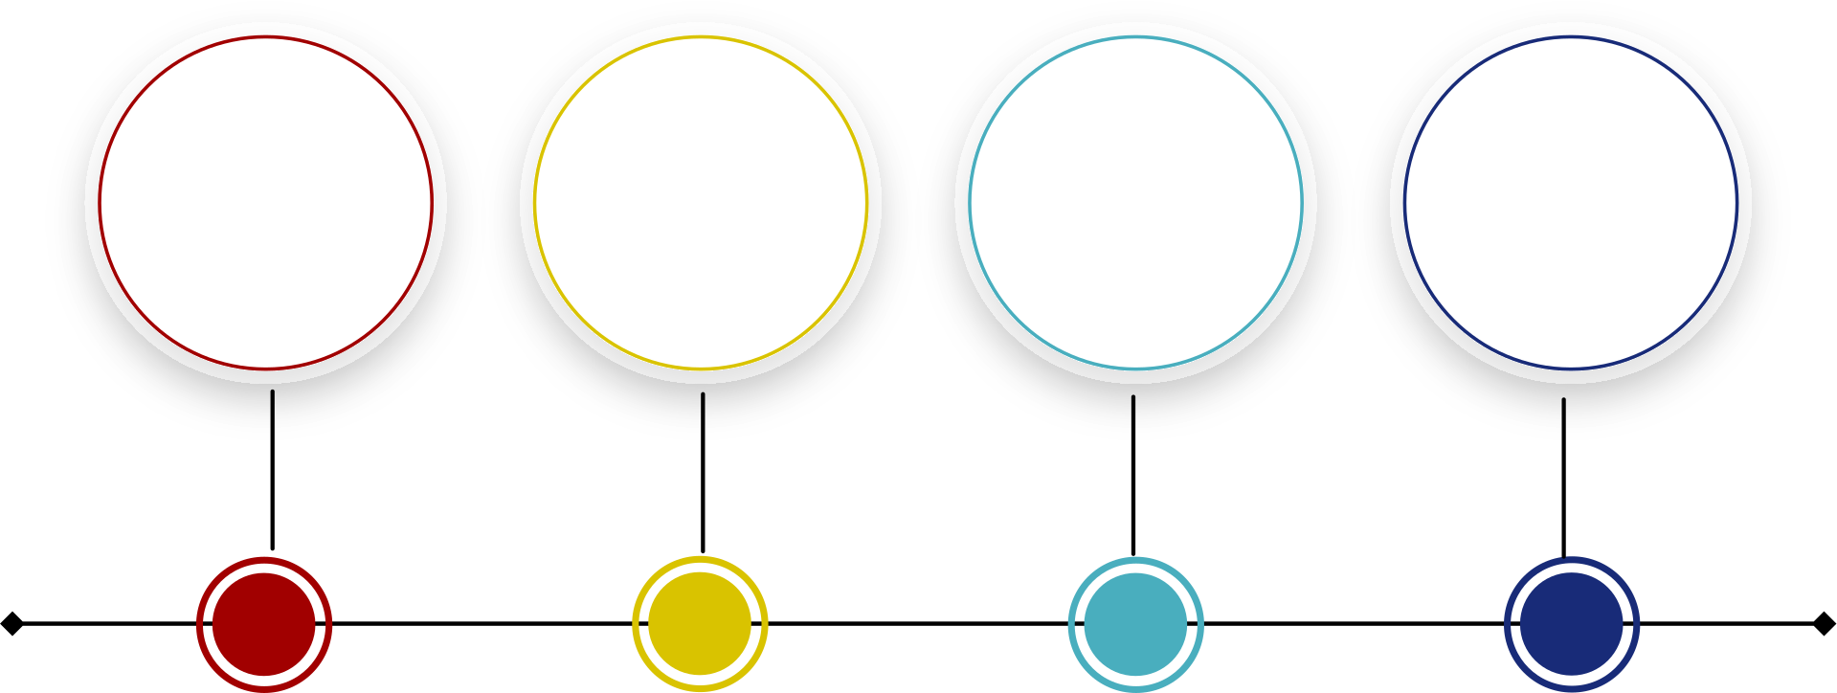
8.
Data Pre -Processing
Data Cleaning
Data Transformation
Data Integration
Data Reduction

Slide 9
Dataset Review:
9.
Dataset: The dataset is a regression dataset with 1197 rows and 15 columns
Source Code:
https://archive.ics.uci.edu/dataset/597/productivity+prediction+of+garment+employees
Variable:
CATEGORICAL VARIABLES
day
quarter
department
CONTINUOUS VARIABLES
team
targeted_productivity
Smv
Wip
over_time
incentive
CONTINOUS VARIABLES
Idle_time
Idle_men
no_of_workers
actual_productivity
no_of_style_change

Slide 10
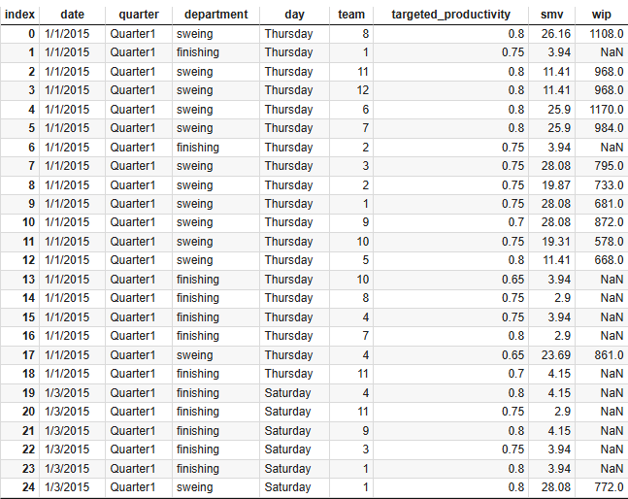
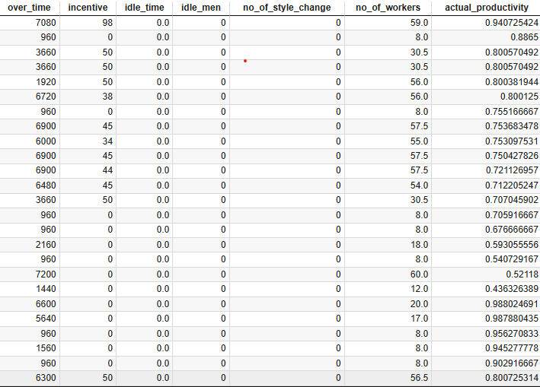
10.
About the dataset:
garment workers' productivity dataset is a detailed collection of
production-related data from a garment factory
dataset is used for regression analysis because the target variable,
actual_productivity, is a continuous numeric variable.

Slide 11



Data Cleaning
11.
1
Converting the ‘day’ column:
Here we converted the day column into binary values
Monday - Friday as 0
Saturday and Sunday as 1
Categorical to Binary

Slide 12
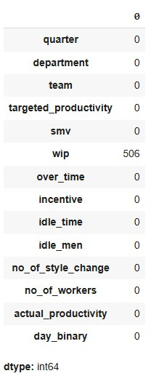
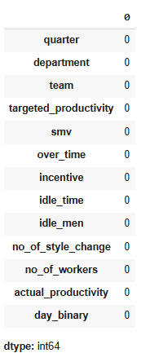
2
12.
Checking For Null Values:
Here we check for any null values in the dataset and replace them using mean , median or mode or remove the column if necessary
Here we removed the ‘wip’ column since the Null values are more

Slide 13
13.
3
Assigning Dummy Variables
-- To perform dummy variable encoding we divided the data into two sets continuous and categorical data
-- The categorical variables are encoded into continuous variablesusing the dummy variables
-- Remaining the columns are
Original Variables | Renamed Variables
quarter | quarter_Quarter1
 | quarter_Quarter2
 | quarter_Quarter3
 | quarter_Quarter4
 | quarter_Quarter5
Original Variables | Renamed Variables
department | department_finishing
 | department_sweing

Slide 14

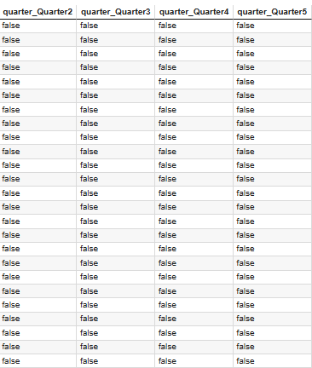
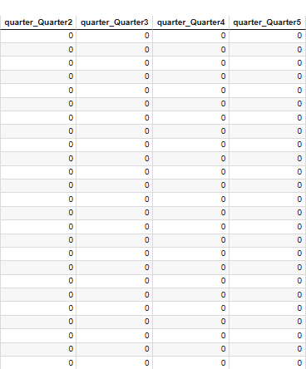
14.
Converting the ‘quarter’ and ‘department’ columns into binary
Here we converted the boolean data which we got after dummy variable encoding , into binary value
Quarter column:
After dummy variables encoding
Boolean to Binary

Slide 15
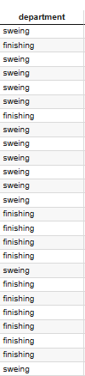
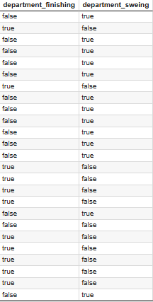
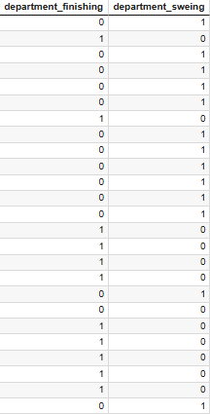
15.
Department column:
After Dummy variables encoding
Boolean to binary

Slide 16
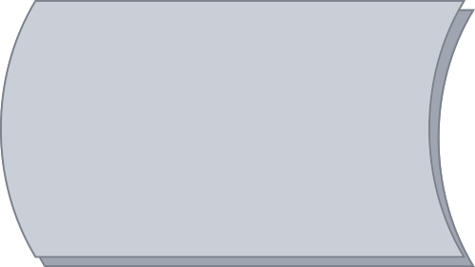

16.
Exploratory Data Analysis

Slide 17
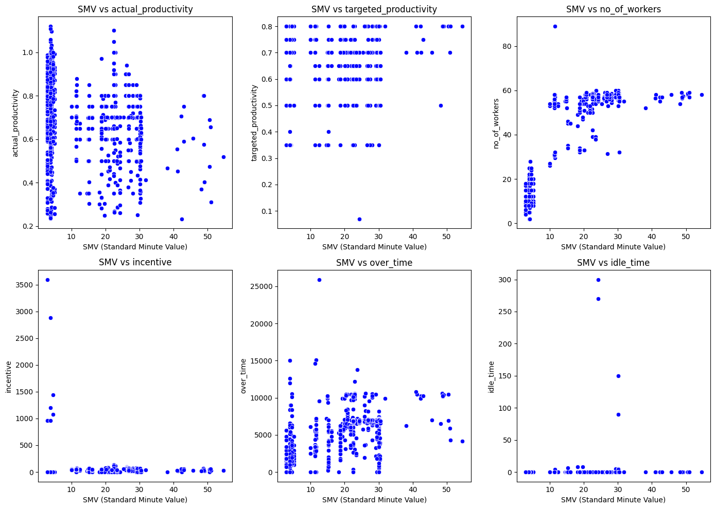
Scatter plot:
17.
Analysis of Standard Minute value(SMV) based on each attribute , SMV as a target variable comparing with each of the columns

Slide 18
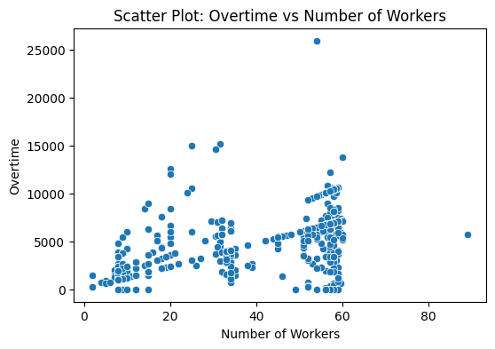
Scatter plot:
18.
Checking the productivity based on the no of workers and the overtime

Slide 19
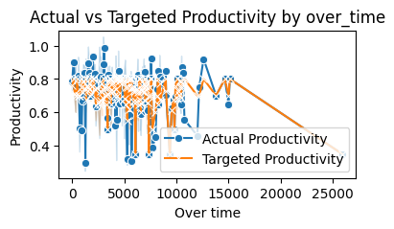
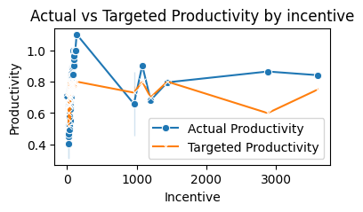
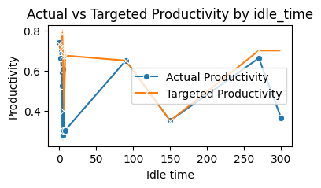
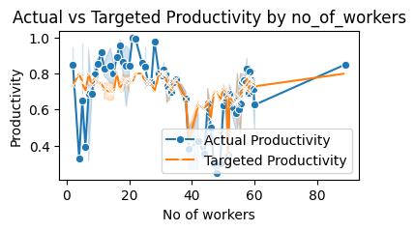
Line Plot:
19.
Comparing Actual productivity and targeted productivitywith each of the columns using line plots

Slide 20
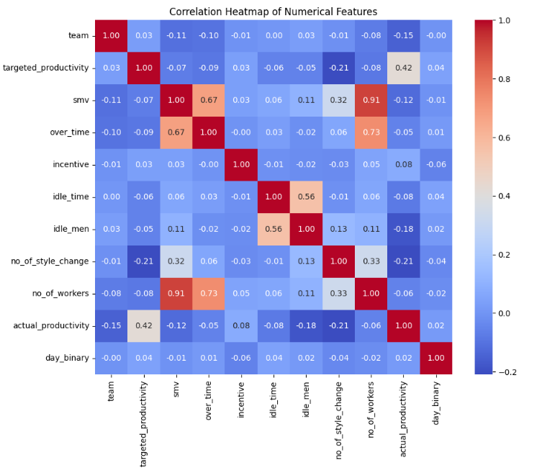
Correlation Matrix:
20.
The correlation gives the overview of the complete dataset, here actual productivity have high positive correlation

Slide 21
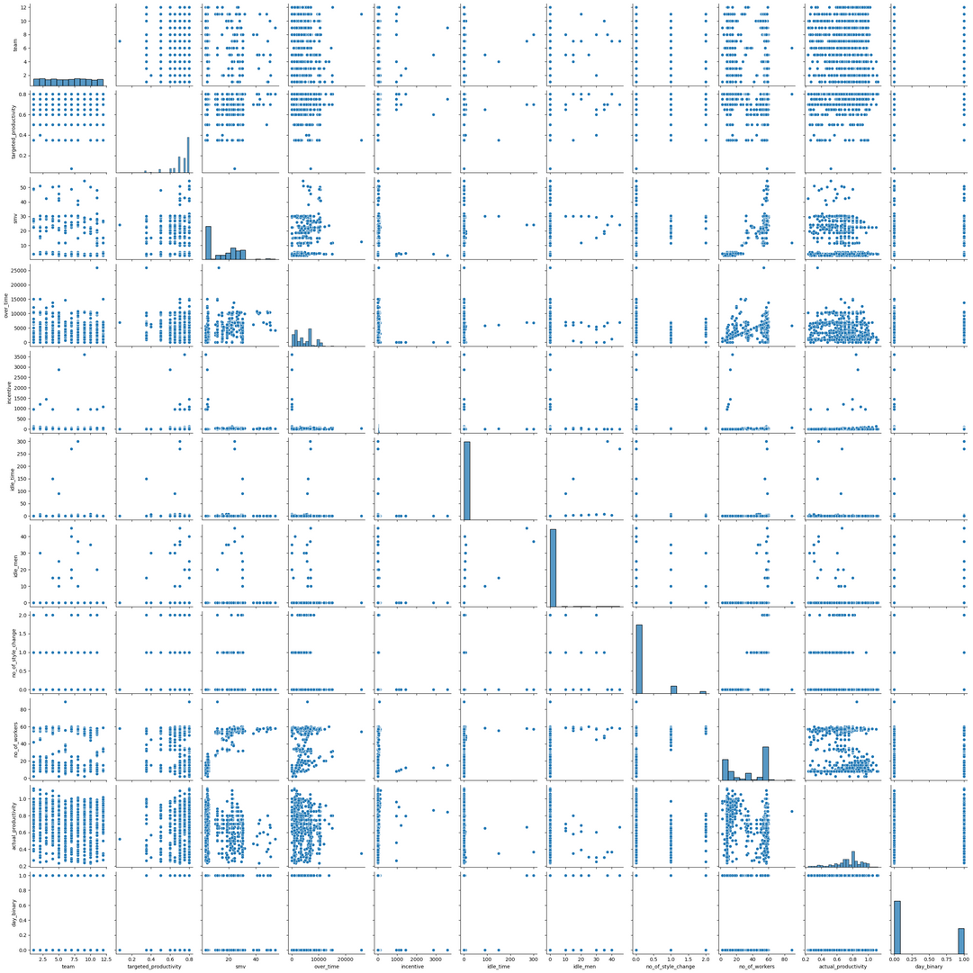
Pair plot:
21.
The scatterplot matrix provides an overview of the relationships between pairs of numerical features in your dataset
It shows potential correlations and patterns among variables, such as targeted_productivity, actual_productivity, smv, over_time, and other factors.

Slide 22
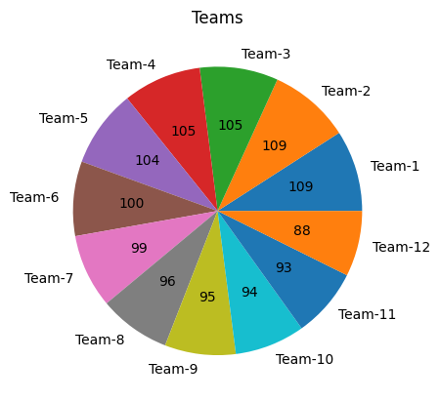
Pie Charts:
22.

Slide 23
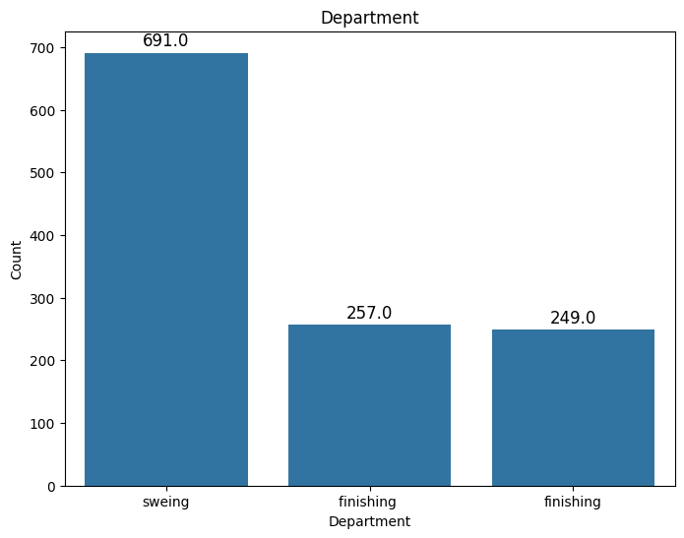
23.
Bar plots:
Department Column

Slide 24
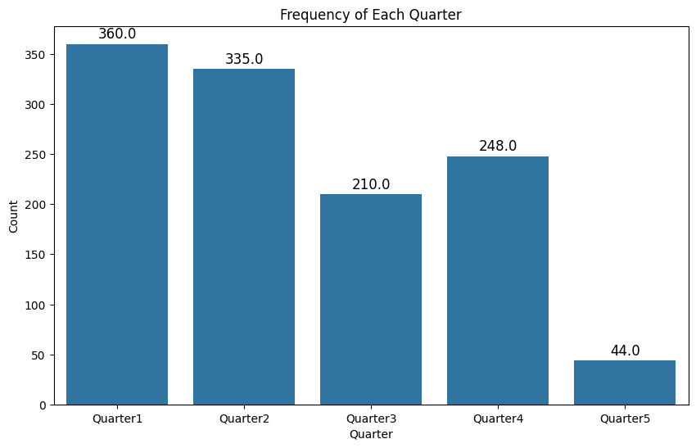
24.
Quarter column

Slide 25
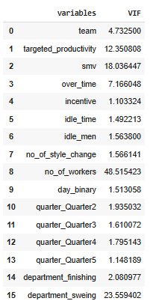
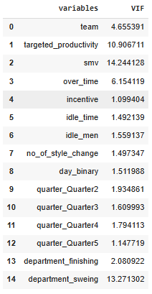
Multicollinearity Checking
25.
Checking the multicollinearity of the dataset using variance inflation factor . here the columns with high correlation are removed,the columns are :no_of_workers','smv','targeted_productivity','department_sweing
no _of_workers column is removed
smv column is removed

Slide 26
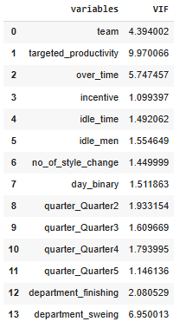
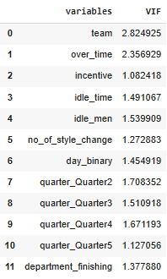
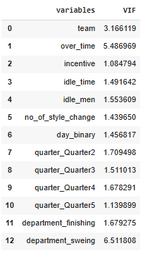
26.
targeted_productivity column is remoned
department_sweing column is removed

Slide 27

27.
MACHINE LEARNING ALGORITHMS

Slide 28
28.
REGRESSION ANALYSIS
KNN
SVM
Machine Learning Algorithms
DECISION TREE
RANDOM FOREST
XGBOOST
ADABOOST

Slide 29

80 - 20 Train_test_split
29.
Algorithm | model1 (r2 score) | model 2 (r2 score) | model 1 MAE | model 2 MAE
Multipe Regreson | -0.3144 | -0.0596 | 0.1281 | 0.1662
KNN | 0.2676 | 0.1599 | 0.1057 | 0.1117
SVM | 0.0255 | 0.0368 | 0.1323 | 0.1228
Decision Tree | 0.4478 | 0.3747 | 0.0777 | 0.0846
Random Forest | 0.5900 | 0.4023 | 0.0689 | 0.0884
XGBoost | 0.5785 | 0.3928 | 0.0692 | 0.0826
ADABoost | 0.2815 | 0.2615 | 0.1018 | 0.1020
r2 score: r_squared is a statistical measure used to evaluate the performance of a regression model
R² = 1: Indicates that the regression model perfectly fits the data
R² = 0: Suggests that the model does not explain any variability in the dependent variable
MAE - “Mean Absolute Error” is a metric used to evaluate the accuracy of a regression model
model 1 before applying VIF
model 2 after applying VIF

Slide 30
75 - 25 Train_test_Split
30.
Algorithm | model1 (r2 score) | model 2 (r2 score) | model 1 MAE | model 2 MAE
Multiple Regression | -0.4605 | -0.0858 | 0.1595 | 0.1320
KNN | 0.2145 | 0.1730 | 0.1089 | 0.1121
SVM | 0.0290 | 0.02736 | 0.1228 | 0.1236
Decision Tree | 0.2099 | 0.3258 | 0.0955 | 0.0879
Random Forest | 0.5092 | 0.3210 | 0.0715 | 0.0884
XGBoost | 0.5019 | 0.3325 | 0.0719 | 0.0872
ADABoost | 0.4215 | 0.2497 | 0.0928 | 0.1020
r2 score: r_squared is a statistical measure used to evaluate the performance of a regression model
R² = 1: Indicates that the regression model perfectly fits the data
R² = 0: Suggests that the model does not explain any variability in the dependent variable
MAE - “Mean Absolute Error” is a metric used to evaluate the accuracy of a regression model
model 1 before applying VIF
model 2 after applying VIF

Slide 31
70 - 30 Train_test_split
31
Algorithm | model1 (r2 score) | model 2 (r2 score) | model 1 MAE | model 2 MAE
Multiple Regression | -0.2538 | -0.0201 | 0.1628 | 0.1312
KNN | 0.2123 | 0.1353 | 0.112 | 0.1175
SVM | 0.0354 | 0.0213 | 0.1300 | 0.1277
Decision Tree | 0.2320 | 0.1315 | 0.1010 | 0.1077
Random Forest | 0.4885 | 0.3546 | 0.0746 | 0.0879
XGBoost | 0.4470 | 0.3654 | 0.0824 | 0.0872
ADABoost | 0.3394 | 0.2670 | 0.1018 | 0.1068
r2 score: r_squared is a statistical measure used to evaluate the performance of a regression model
R² = 1: Indicates that the regression model perfectly fits the data
R² = 0: Suggests that the model does not explain any variability in the dependent variable
MAE - “Mean Absolute Error” is a metric used to evaluate the accuracy of a regression model
model 1 before applying VIF
model 2 after applying VIF

Slide 32
60 - 40 Train_test_split
32.
Algorithm | model1 (r2 score) | model 2 (r2 score) | model 1 MAE | model 2 MAE
Multiple Regression | -0.2161 | -0.8512 | 0.1518 | 0.1578
KNN | 0.1595 | 0.1162 | 0.1264 | 0.1171
SVM | 0.0195 | 0.0097 | 0.1415 | 0.1288
Decision Tree | 0.2749 | 0.2784 | 0.0899 | 0.0896
Random Forest | 0.5094 | 0.3180 | 0.0773 | 0.0891
XGBoost | 0.4276 | 0.3215 | 0.0796 | 0.0891
ADABoost | 0.4215 | 0.2092 | 0.1073 | 0.1102
r2 score: r_squared is a statistical measure used to evaluate the performance of a regression model
R² = 1: Indicates that the regression model perfectly fits the data
R² = 0: Suggests that the model does not explain any variability in the dependent variable
MAE - “Mean Absolute Error” is a metric used to evaluate the accuracy of a regression model
model 1 before applying VIF
model 2 after applying VIF

Slide 33
Algorithms Comparison
33.
60 - 40 Train_test_split before vif
60 - 40 Train_test_split after vif
Algorithm | model1 (r2 score) | model 1 MAE
Multiple Regression | -0.2161 | 0.1518
KNN | 0.1595 | 0.1264
SVM | 0.0195 | 0.1415
Decision Tree | 0.2749 | 0.0899
Random Forest | 0.5094 | 0.0773
XGBoost | 0.4276 | 0.0796
ADABoost | 0.4215 | 0.1073
Algorithm | model 2 (r2 score) | model 2 MAE
Multiple Regression | -0.8512 | 0.1578
KNN | 0.1162 | 0.1171
SVM | 0.0097 | 0.1288
Decision Tree | 0.2784 | 0.0896
Random Forest | 0.3280 | 0.0891
XGBoost | 0.3115 | 0.0891
ADABoost | 0.2092 | 0.1102

Slide 34

NEURAL NETWORKS
34.
Before Multicollinearity Checking
Train_test | Architecture | Optimizer | Epochs | MAE | loss | Precision | Recall
80 - 20 | 30-20-18-8-1 | Adam | 150 | 0.1241 | 0.1241 | 0.1250 | 0.1250
75 - 25 | 30-20-18-8-1 | Adam | 150 | 0.1231 | 0.1231 | 0.1255 | 0.1255
70 - 30 | 30-20-18-8-1 | Adam | 150 | 0.1258 | 0.1258 | 0.13101 | 0.1310
60 - 40 | 30-20-18-8-1 | Adam | 150 | 0.1293 | 0.1293 | 0.1321 | 0.1321

Slide 35
NEURAL NETWORKS
35.
After Multicollinearity Checking
Train_test | Architecture | Optimizer | Epochs | MAE | loss | Precision | Recall
80 - 20 | 30-20-18-8-1 | Adam | 150 | 0.1231 | 0.1231 | 0.12472 | 0.12472
75 - 25 | 30-20-18-8-1 | Adam | 150 | 0.1747 | 0.1747 | 0.1753 | 0.1753
70 - 30 | 30-20-18-8-1 | Adam | 150 | 0.1672 | 0.1672 | 0.1709 | 0.17093
60 - 40 | 30-20-18-8-1 | Adam | 150 | 0.1493 | 0.1493 | 0.1522 | 0.1522

Slide 36
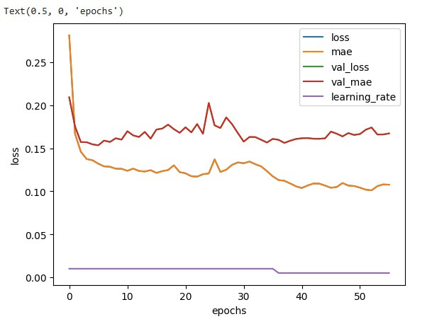
Neural Network plot for observation
36.
Train_test_split | 75 - 25
Architecture | 30-20-18-8-1
Optimizer | Adam
Epochs | 150

Slide 37
37.
Summary
This project aimed to analyze and predict the productivity of garment workers by
using a comprehensive dataset containing various features related to worker
output and operational conditions.
So for the actual data we have the Random Forest showing the best result with a r2 score of
0.5094 and MAE of 0.0773
As for the data after multicollinearity checking , XGBoost algorithm shows the best result
with r2 score of 0.3115 , MAE of 0.0891 and the Random Forest is showing the next best result
key stages included examining multicollinearity using the variance inflation factor (VIF) to
ensure the reliability of the features selected for modelling

Slide 38
38.
Insights
Analysis revealed that number of workers, overtime, targeted productivity, and incentives are significant drivers of actual productivity.
Checking multicollinearity using VIF helped identify highly correlated features, ensuring that only reliable features were used for predictive modeling.
The analysis suggested that adjusting workforce size and strategically applying incentives can positively impact productivity.
These insights provide a foundation for data driven decision-making to optimize labor management and improve productivity outcomes in the garment industry.

Slide 39
Future Scope:
39.
1.) Incorporating External Data: Integrating external data like weather conditions, fabric types, or economic indicators could provide additional insights that might influence worker productivity.
2.)Scalability and Deployment: Transforming the model into a deployable tool that can be scaled across multiple manufacturing plants could help in real-world decision-making.
3.)Predictive Maintenance: Leveraging predictive analytics for equipment and workflow management could help minimize idle time and improve operational efficiency.

Slide 40


40.
Work Distribution
Vamshi | Collecting information about the garment worker’s productivity
Nithin Chandra | Data Pre-Processing
Sri Vani | Exploratory Data Analysis
Sravan Kumar | Implement Machine Learning Algorithms

Slide 41

41.
Colob Notebook
Thank You
SRAVAN KUMAR - 107222546009
VAMSHI - 107222546010
SRI VANI - 107222546011
NITHIN CHANDRA - 107222546012

Slide 42
42.
Appendix

Slide 43
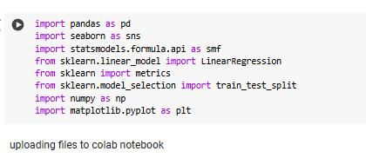
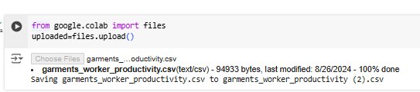
43.
importing libraries
uploading the dataset

Slide 44
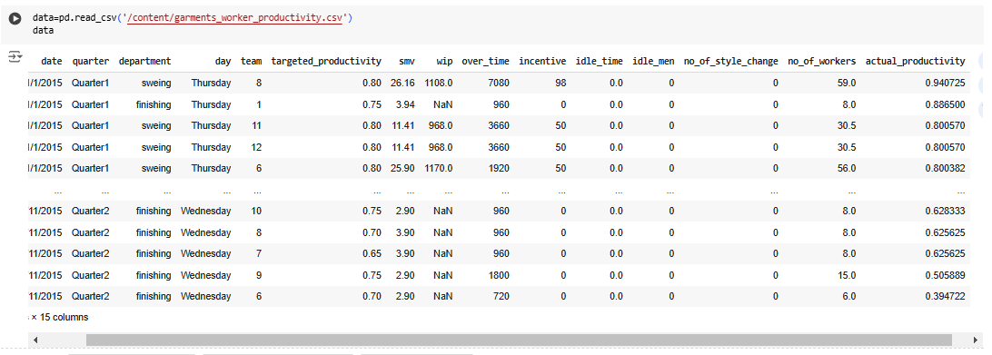
44.
loading the dataset

Slide 45
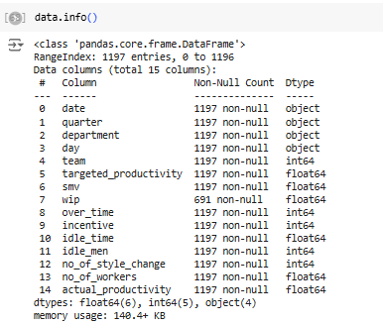
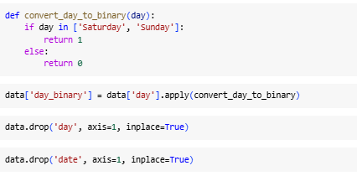
45.
converting day column to binary
data types of the data

Slide 46
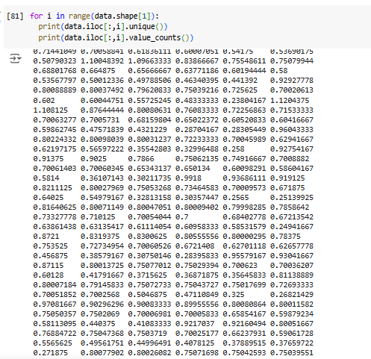
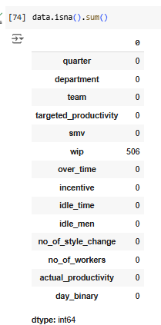
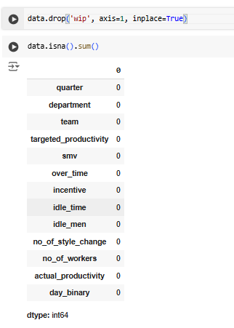
46.
removing the null values column
finding unique values
checking for null values

Slide 47
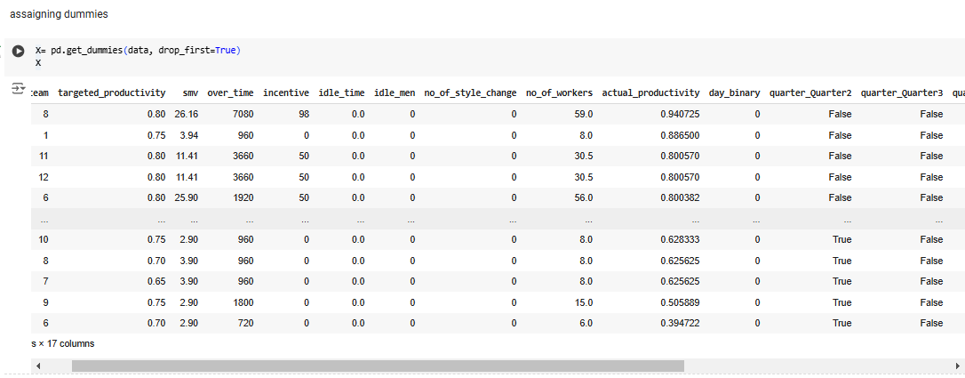
47.
dummy variable encoding

Slide 48
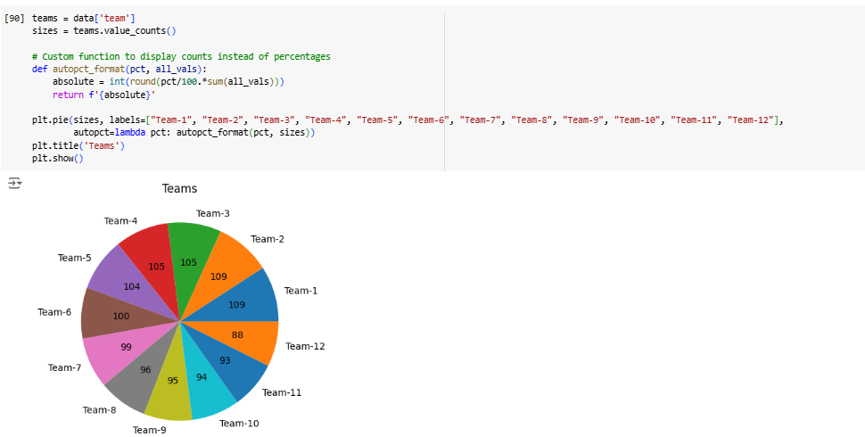
48.
pie chart

Slide 49
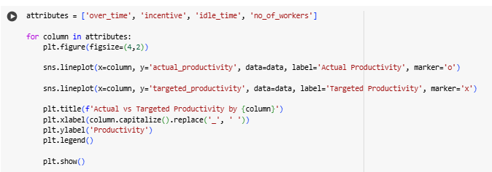
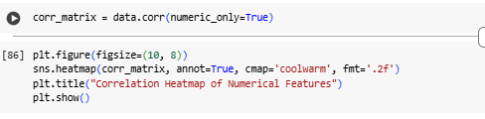
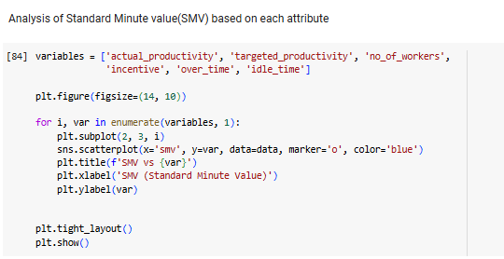
49.
Line plot
Correlation heatmap
Scatter plot

Slide 50
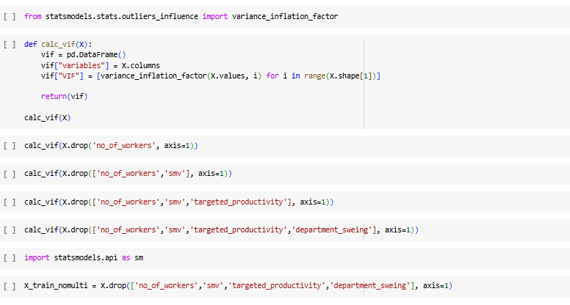
Multicollinearity Checking
50.

Slide 51
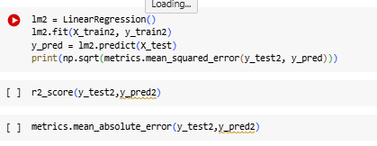
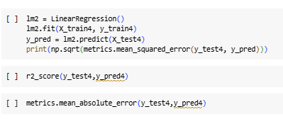
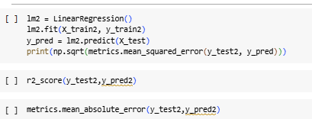
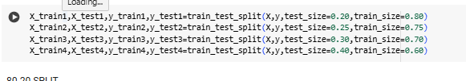
51.
Multiple regression

Slide 52
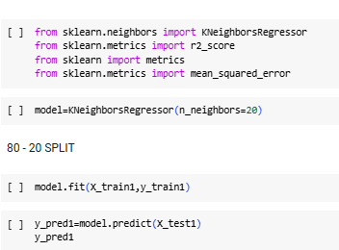
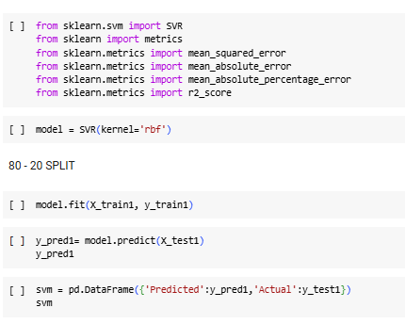
52.
SVM algorithm
KNN alogorithm

Slide 53
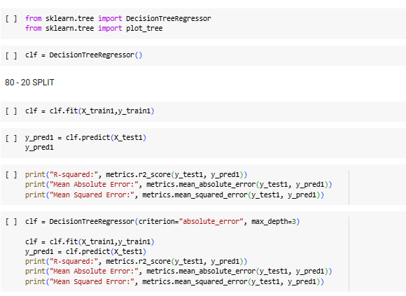
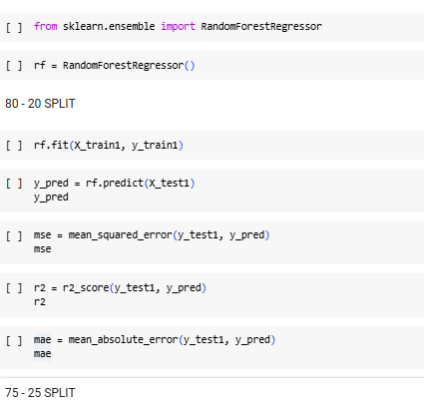
53.
Random Forest
Decision Tree

Slide 54


54.
ADABoost
XGBoost

Slide 55

NEURAL NETWORKS
55.
75-25 TRAIN_TEST_SPLIT
BEFORE MULTICOLLINEARITY CHECKING

